Slide 1
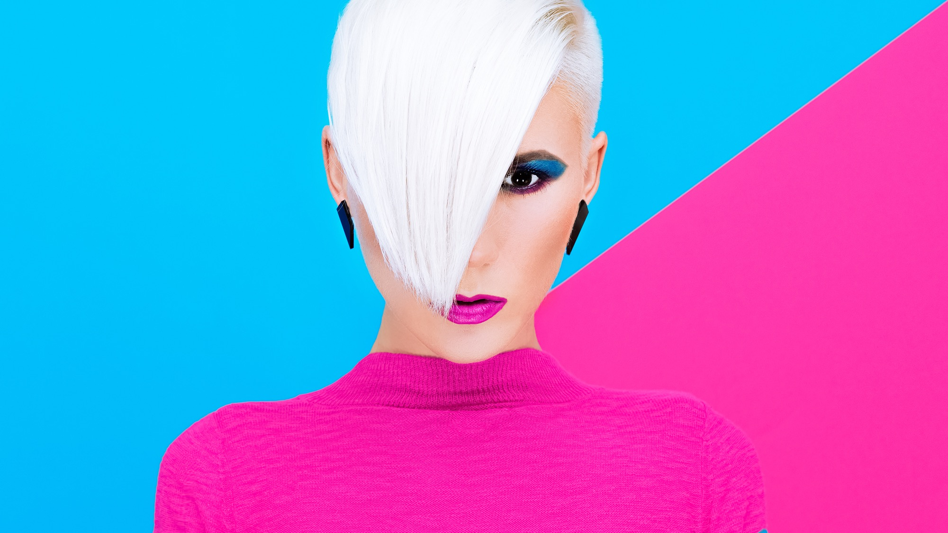
GLAM DOLL
BECAUSE YOU’RE GORGEOUS
POPPING PIGMENTS, PROGRESSIVE PACKAGING AND POWER PRICING

Slide 2
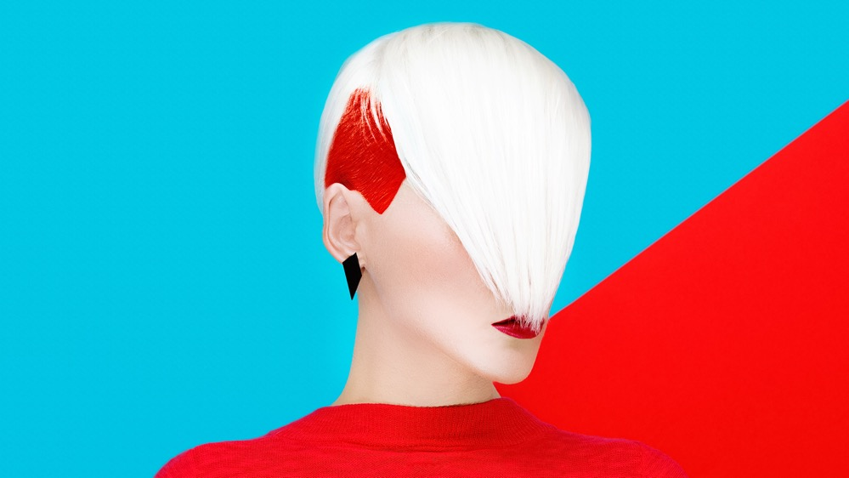
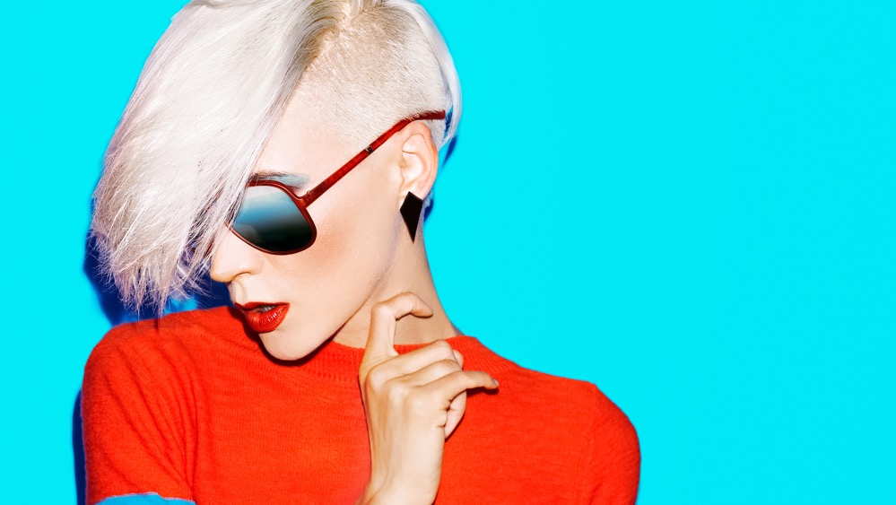
GLAM DOLL
FUNKY FRESH, 100% CRUELTY FREE, MASS MARKET, TRENDY COLOUR COSMETICS OF GREAT QUALITY, AND ALWAYS ON FLEEK.
BECAUSE YOU’RE GORGEOUS
GLAM DOLL IS A NEW VISIONARY COLOUR COSMETIC BRAND THAT OFFERS QUALITY PRODUCTS, IN SUPER STYLISH PACKAGING, COMMITTED TO OFFERING YOUR CUSTOMERS THE VALUE THAT THEY WANT, WHILST FULFILLING THE CUSTOMER DEMANDS THAT 2018 HAS BROUGHT – VEGETARIAN/VEGAN PRODUCTS THAT STILL PACK A PUNCH OF COLOUR POP AND DURABILITY. ​
​
FOCUSED ON MULTI FUNCTIONALITY AND QUALITY, WE USE PIGMENTS THAT WORK AS WELL ON DARK SKIN AS THEY DO ON LIGHT SKIN AND ALL TONES IN BETWEEN.​
​
GLAM DOLL DRAWS IT'S PACKAGING GRAPHIC DESIGN ON RETRO “TRUE STORY” MAGAZINE POP ART AND IT’S COLOURING SCHEMES ARE THEMED PRIMARILY FOR BOLD NEW MILLENIALS WHO REQUIRE A DIFFERENT LOOK EVERY DA

Slide 3

GLAM DOLL IS FUNKY FRESH, AND 100% CRUELTY FREE. WE ARE SUPER TREND LED WITH OUR HIGH COLOUR COSMETICS WHICH DRIVE IMPULSE PURCHASES AND FOOTFALL, DEVELOPING A NEW CUSTOMER DEMOGRAPHIC AND CREATING A DESTINATION STORE.
GLAM DOLL COMPRISES OF:
GLAM DOLL LIPSTICKS IN MULTIPLE TYPES & FINISHES;
THE GLAM DOLL EXTENSIVE RANGE OF EYE SHADOW SINGLES IN MULTIPLE FINISHES;
TREND-SETTING AND TRULY INSPIRING HIGHLIGHTERS, PRIMERS, FACE POWDERS & CONCEALERS;
GLAM DOLL NAIL POLISHES WHICH ARE ONE OF A KIND AND CREATE HIGH PIGMENTED FLASH OF GLAM IN SECONDS.
WHY GLAM DOLL?
BECAUSE YOU’RE GORGEOUS
GLAM DOLL
THE GLAMMEST BRAND AROUND WITH THE NEWEST TRENDS AT AN INCLUSIVE PRICE.

Slide 4
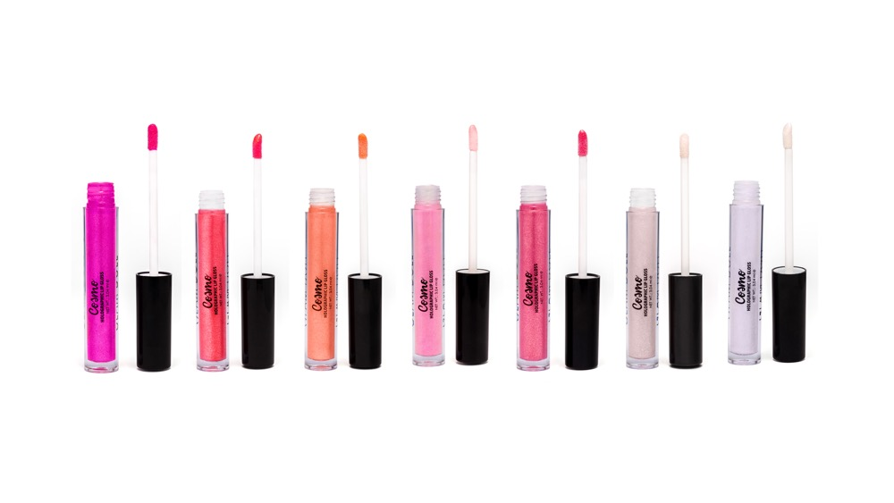
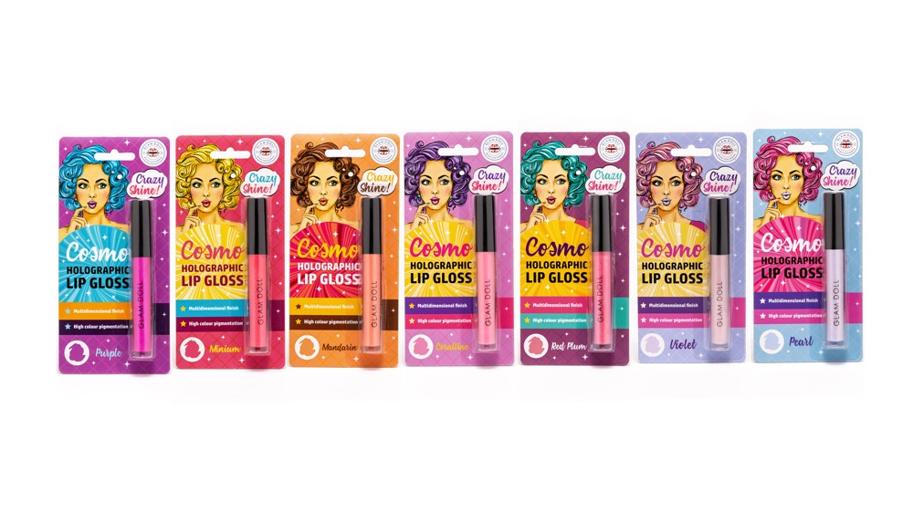
COSMO
HOLOGRAPHIC LIP GLOSS
8 COLOURS
3.04 ml ℮ EACH
PURPLE ITEM CODE: 1B1070 UPC: 5060565381728
MINIUM ITEM CODE: 1B1071 UPC: 5060565381735
MANDARIN ITEM CODE: 1B1072 UPC: 5060565381742
CORALLINE ITEM CODE: 1B1073 UPC: 5060565381759
RED PLUM ITEM CODE: 1B1074 UPC: 5060565381766
VIOLET ITEM CODE: 1B1075 UPC: 5060565381773
CHROME YELLOW^{NEW} ITEM CODE: 1B1076 UPC: 5060565381780
PEARL ITEM CODE: 1B1077 UPC: 5060565381797
© 2018 MIRADOR HOLDINGS LIMITED
© 2018 MIRADOR HOLDINGS LIMITED

Slide 5
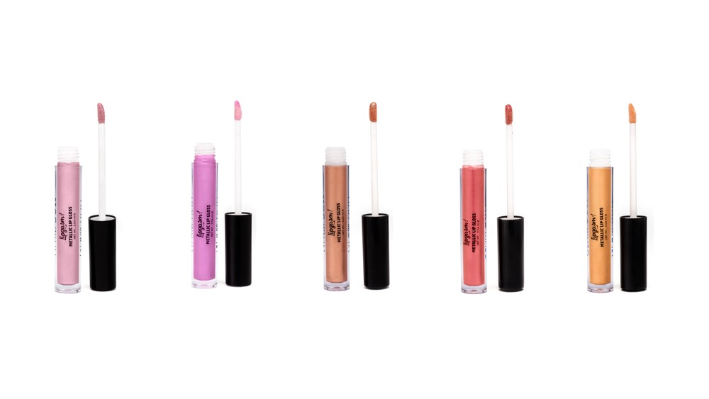
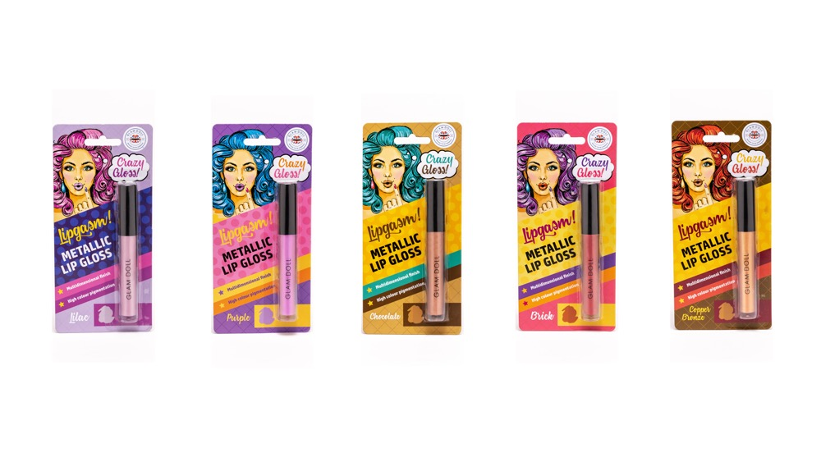
LIPGASM
METALLIC LIP GLOSS
8 COLOURS
3.04 ml ℮ EACH
LILAC ITEM CODE: 1B1080 UPC: 5060565381803
PURPLE ITEM CODE: 1B1081 UPC: 5060565381810
CHOCOLATE ITEM CODE: 1B1082 UPC: 5060565381827
BRICK ITEM CODE: 1B1083 UPC: 5060565381834
COPPER BRONZE ITEM CODE: 1B1084 UPC: 5060565381841
MANDARIN^{NEW} ITEM CODE: 1B1085 UPC: 5060565382169
MINIUM^{NEW} ITEM CODE: 1B1086 UPC: 5060565382176
CORALLINE^{NEW} ITEM CODE: 1B1087 UPC: 5060565382183
© 2018 MIRADOR HOLDINGS LIMITED
© 2018 MIRADOR HOLDINGS LIMITED

Slide 6
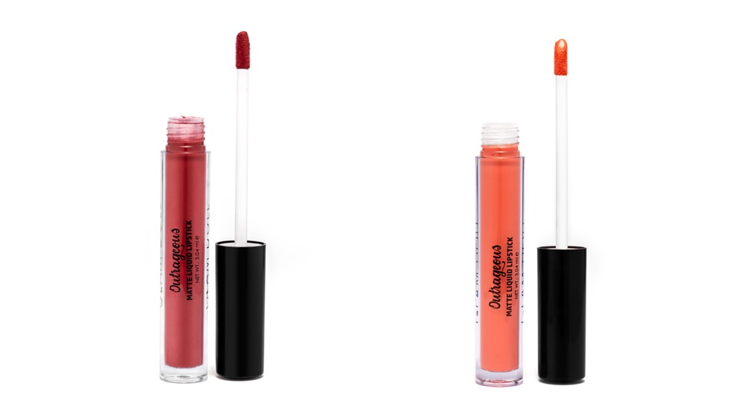
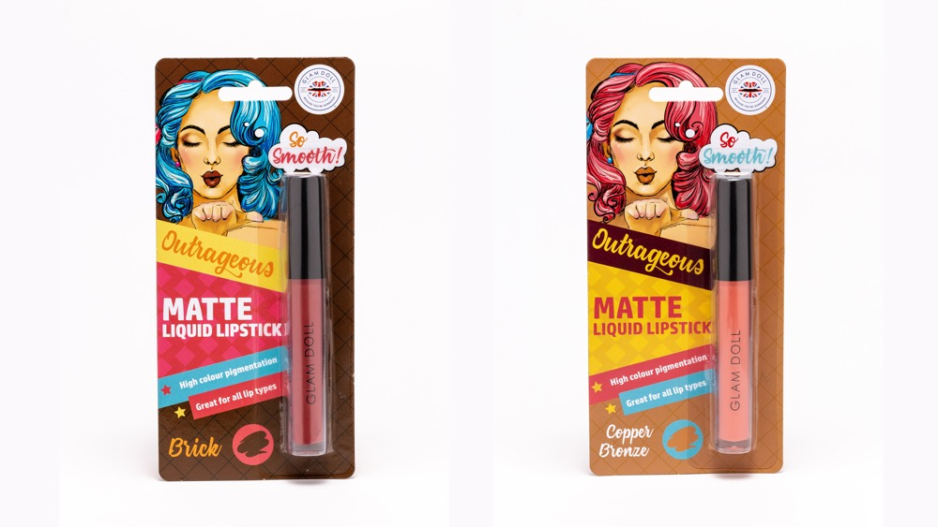
OUTRAGEOUS
MATTE LIQUID LIPSTICK
8 COLOURS
3.04 ml ℮ EACH
BRICK ITEM CODE: 1B1090 UPC: 5060565381858
COPPER BRONZE ITEM CODE: 1B1091 UPC: 5060565381865
PEACH^{NEW} ITEM CODE: 1B1092 UPC: 5060565382190
CORAL^{NEW} ITEM CODE: 1B1093 UPC: 5060565382206
BEIGE^{NEW} ITEM CODE: 1B1094 UPC: 5060565382213
PLUM^{NEW} ITEM CODE: 1B1095 UPC: 5060565382220
TERRACOTTA^{NEW} ITEM CODE: 1B1096 UPC: 5060565382237
FUCHSIA^{NEW} ITEM CODE: 1B1097 UPC: 5060565382244

Slide 7
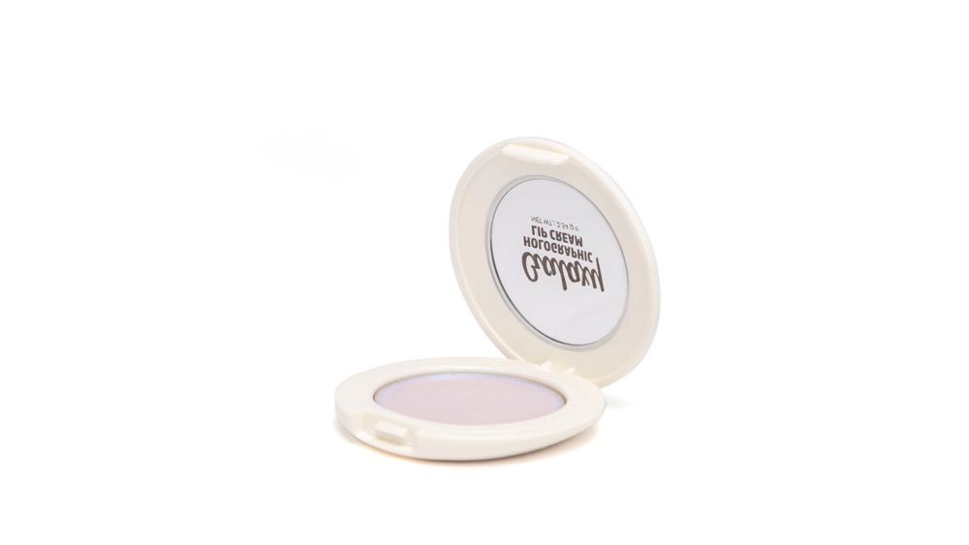
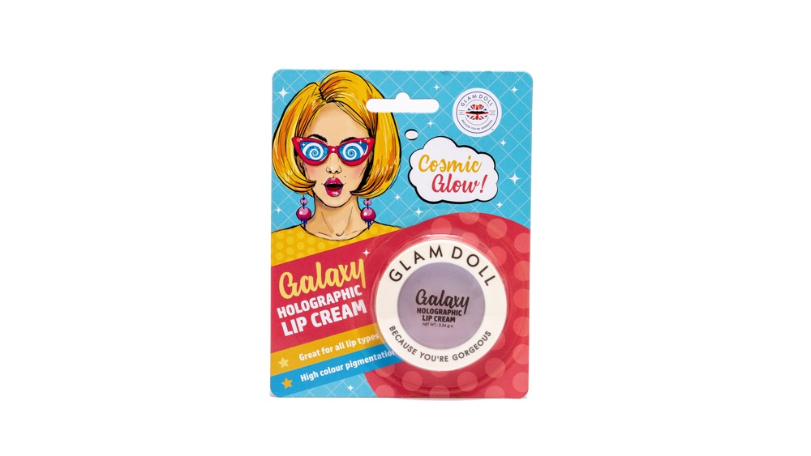
GALAXY
HOLOGRAPHIC LIP CREAM
2.54 g ℮
ITEM CODE: 1B1100
BARCODE: 5060565381872
© 2018 MIRADOR HOLDINGS LIMITED
© 2018 MIRADOR HOLDINGS LIMITED

Slide 8
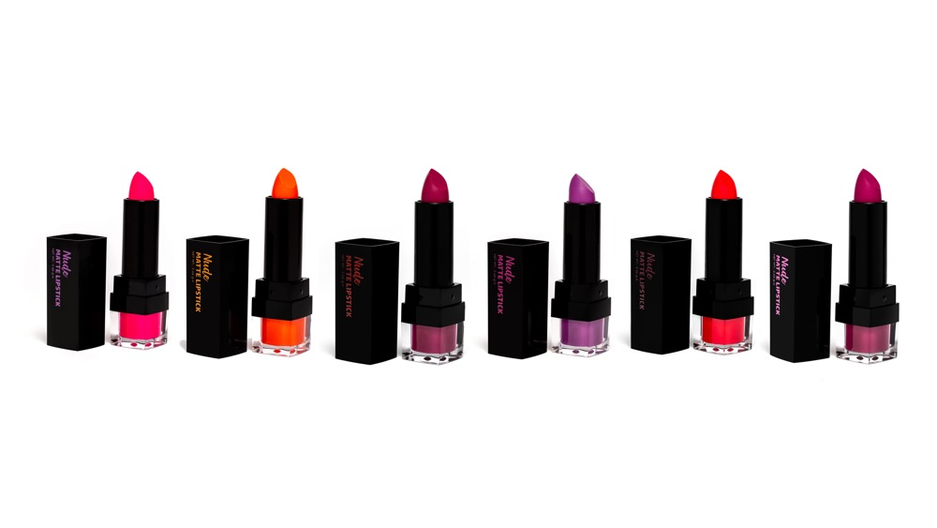
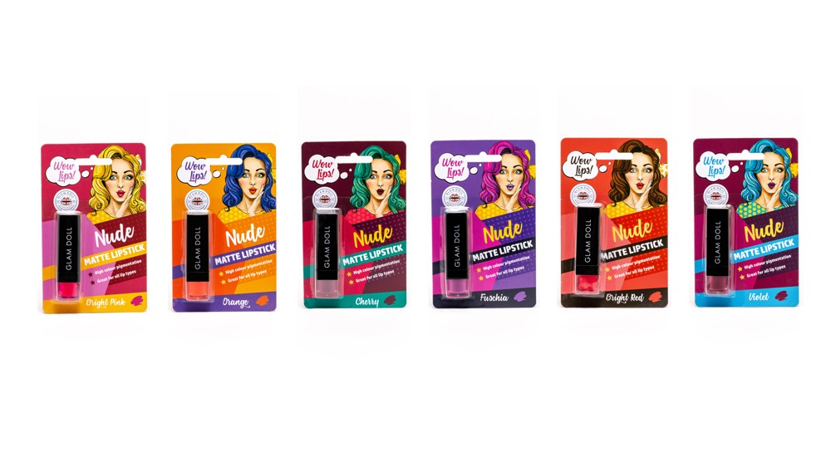
NUDE
MATTE LIPSTICK
8 COLOURS
2.66 g ℮ EACH
BRIGHT PINK ITEM CODE: 1B1110 UPC: 5060565381889
ORANGE ITEM CODE: 1B1111 UPC: 5060565381896
CHERRY ITEM CODE: 1B1112 UPC: 5060565381902
FUCHSIA ITEM CODE: 1B1113 UPC: 5060565381919
BRIGHT RED ITEM CODE: 1B1114 UPC: 5060565381926
VIOLET ITEM CODE: 1B1115 UPC: 5060565381933
SANGRIA^{NEW} ITEM CODE: 1B1116 UPC: 5060565382251
WARM CORAL^{NEW} ITEM CODE: 1B1117 UPC: 5060565382268
© 2018 MIRADOR HOLDINGS LIMITED
© 2018 MIRADOR HOLDINGS LIMITED

Slide 9
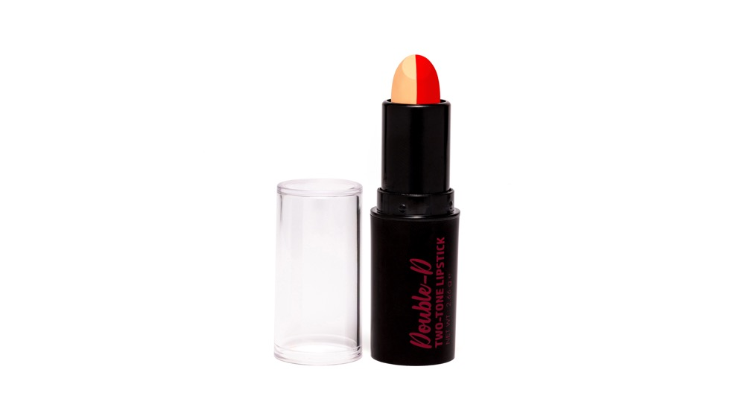
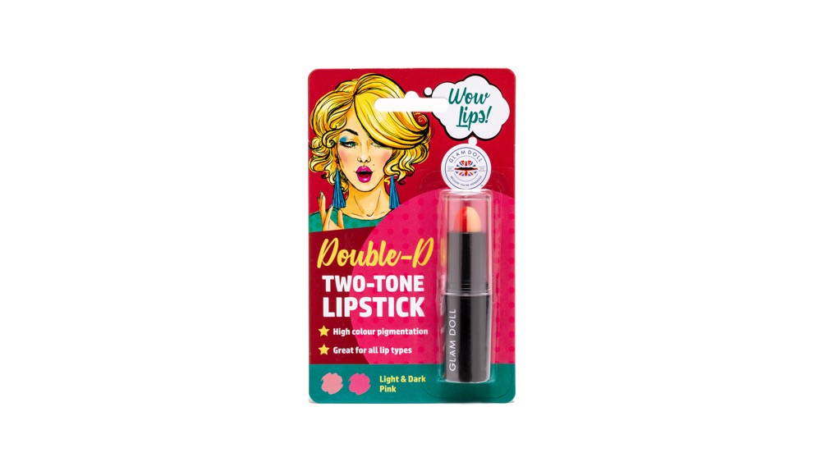
DOUBLE-D
TWO-TONE LIPSTICK
8 COLOURS
2.66 g ℮ EACH
PINK ITEM CODE: 1B1120 UPC: 5060565381940
ORANGE FLAME^{NEW} ITEM CODE: 1B1121 UPC: 5060565382282
BARE^{NEW} ITEM CODE: 1B1122 UPC: 5060565382299
CORAL^{NEW} ITEM CODE: 1B1123 UPC: 5060565382305
RASPBERRY^{NEW} ITEM CODE: 1B1124 UPC: 5060565382312
ROSE^{NEW} ITEM CODE: 1B1125 UPC: 5060565382329
FUCHSIA^{NEW} ITEM CODE: 1B1126 UPC: 5060565382336
NUDE^{NEW} ITEM CODE: 1B1127 UPC: 5060565382343
© 2018 MIRADOR HOLDINGS LIMITED
© 2018 MIRADOR HOLDINGS LIMITED

Slide 10
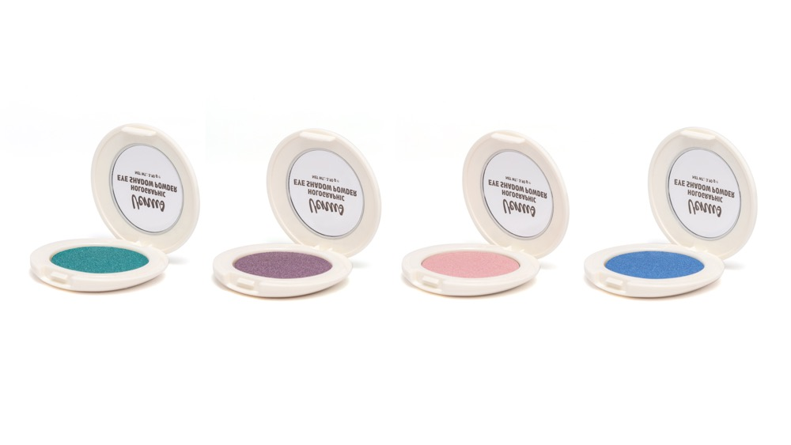
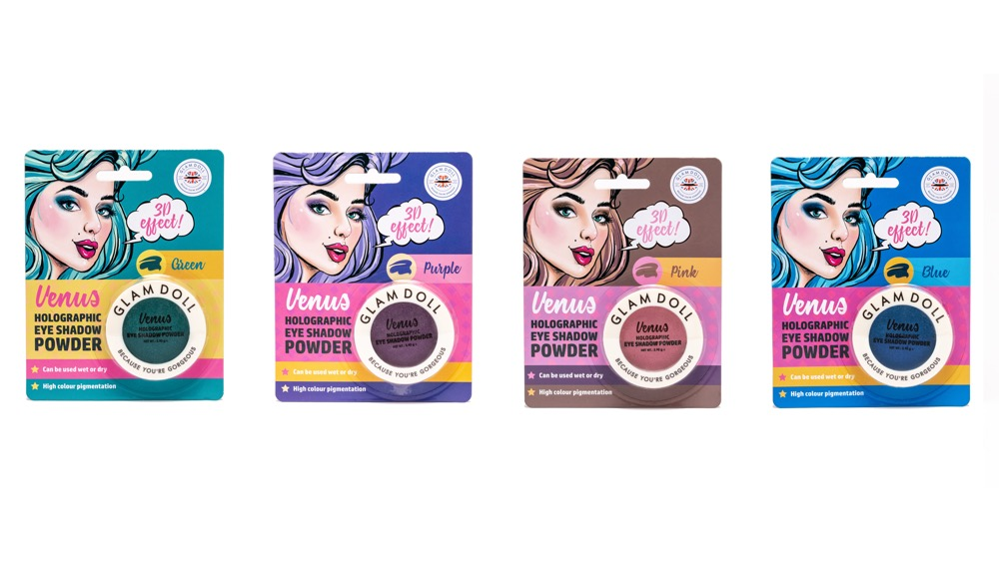
VENUS
HOLOGRAPHIC EYE SHADOW POWDER
6 COLOURS
3.90 g ℮ EACH
GREEN ITEM CODE: 1B1010 UPC: 5060565381506
PURPLE ITEM CODE: 1B1011 UPC: 5060565381513
PINK ITEM CODE: 1B1012 UPC: 5060565381520
BLUE ITEM CODE: 1B1013 UPC: 5060565381537
WHITE GLITTER^{NEW} ITEM CODE: 1B1014 UPC: 5060565382053
CHAMPAGNE GLITTER^{NEW} ITEM CODE: 1B1015 UPC: 5060565382060
© 2018 MIRADOR HOLDINGS LIMITED
© 2018 MIRADOR HOLDINGS LIMITED

Slide 11
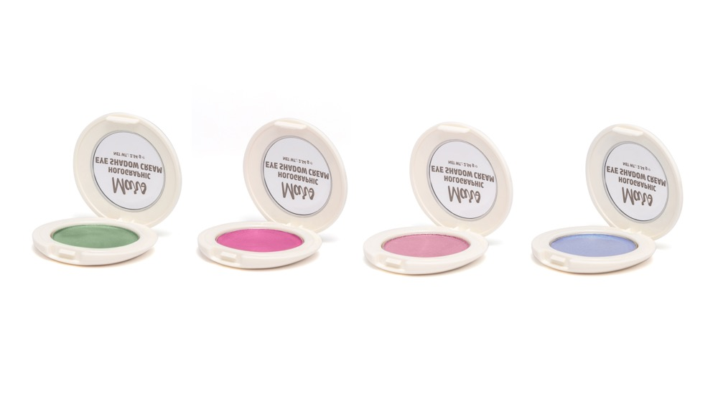
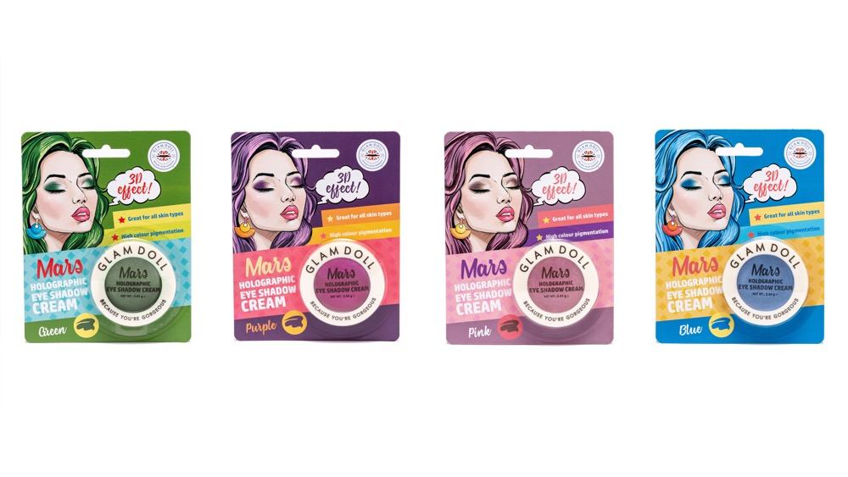
MARS
HOLOGRAPHIC EYE SHADOW CREAM
6 COLOURS
2.54 g ℮ EACH
GREEN ITEM CODE: 1B1020 UPC: 5060565381544
PURPLE ITEM CODE: 1B1021 UPC: 5060565381551
PINK ITEM CODE: 1B1022 UPC: 5060565381568
BLUE ITEM CODE: 1B1023 UPC: 5060565381575
WHITE GLITTER^{NEW} ITEM CODE: 1B1024 UPC: 5060565382077
CHAMPAGNE GLITTER^{NEW} ITEM CODE: 1B1025 UPC: 5060565382084
© 2018 MIRADOR HOLDINGS LIMITED
© 2018 MIRADOR HOLDINGS LIMITED

Slide 12
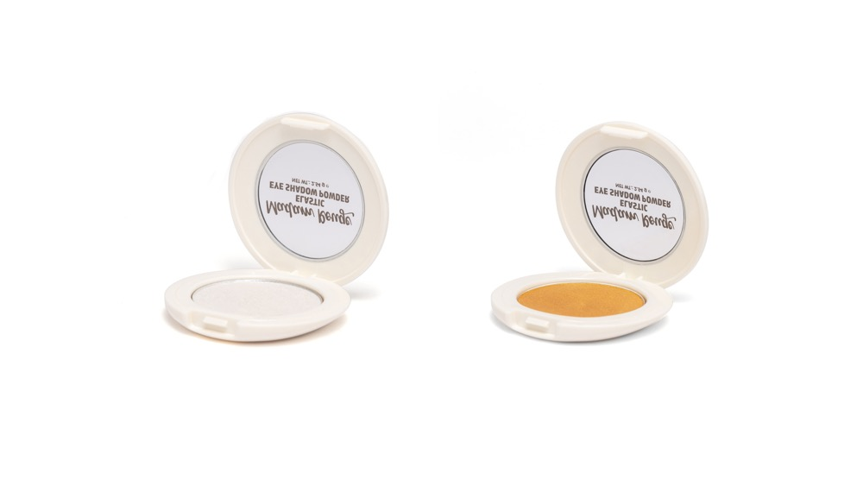
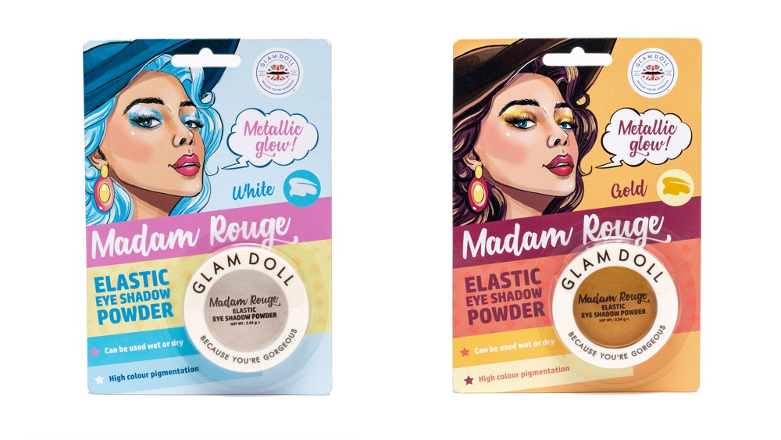
MADAM ROUGE
ELASTIC EYE SHADOW POWDER
6 COLOURS
2.54 g ℮ EACH
WHITE ITEM CODE: 1B1050 UPC: 5060565381629
GOLD ITEM CODE: 1B1051 UPC: 5060565381636
GLITTER SILVER^{NEW} ITEM CODE: 1B1052 UPC: 5060565382121
GLITTER GOLD^{NEW} ITEM CODE: 1B1053 UPC: 5060565382138
GLITTER PINK^{NEW} ITEM CODE: 1B1054 UPC: 5060565382145
GLITTER BRONZE^{NEW} ITEM CODE: 1B1055 UPC: 5060565382152
© 2018 MIRADOR HOLDINGS LIMITED
© 2018 MIRADOR HOLDINGS LIMITED

Slide 13
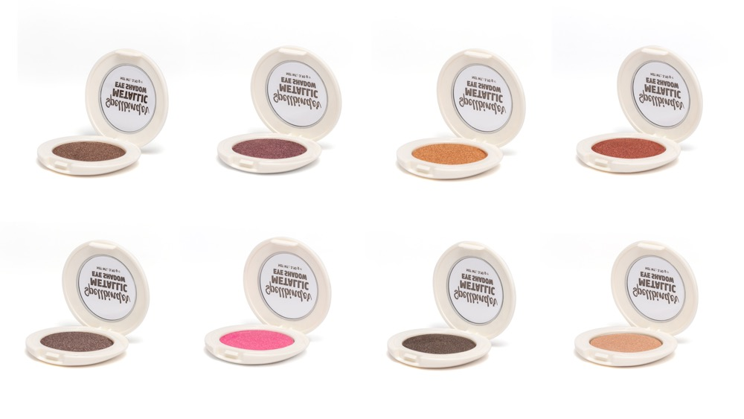
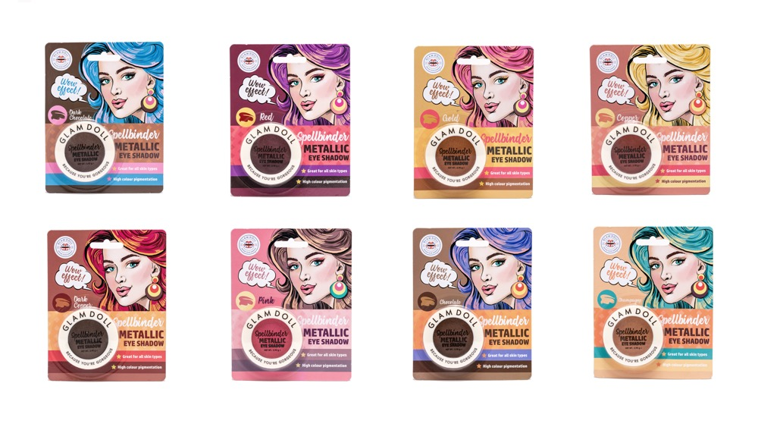
SPELLBINDER
METALLIC EYE SHADOW
8 COLOURS
3.90 g ℮ EACH
DARK CHOCOLATE ITEM CODE: 1B1060 UPC: 5060565381643
RED ITEM CODE: 1B1061 UPC: 5060565381650
GOLD ITEM CODE: 1B1062 UPC: 5060565381667
COPPER ITEM CODE: 1B1063 UPC: 5060565381674
DARK COPPER ITEM CODE: 1B1064 UPC: 5060565381681
PINK ITEM CODE: 1B1065 UPC: 5060565381698
CHOCOLATE ITEM CODE: 1B1066 UPC: 5060565381704
CHAMPAGNE ITEM CODE: 1B1067 UPC: 5060565381711
© 2018 MIRADOR HOLDINGS LIMITED
© 2018 MIRADOR HOLDINGS LIMITED

Slide 14
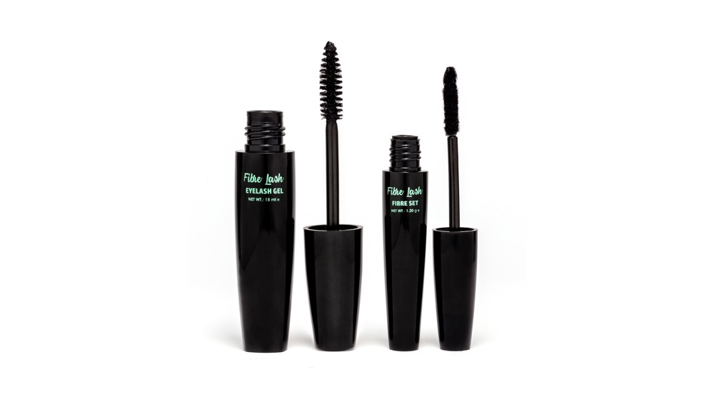
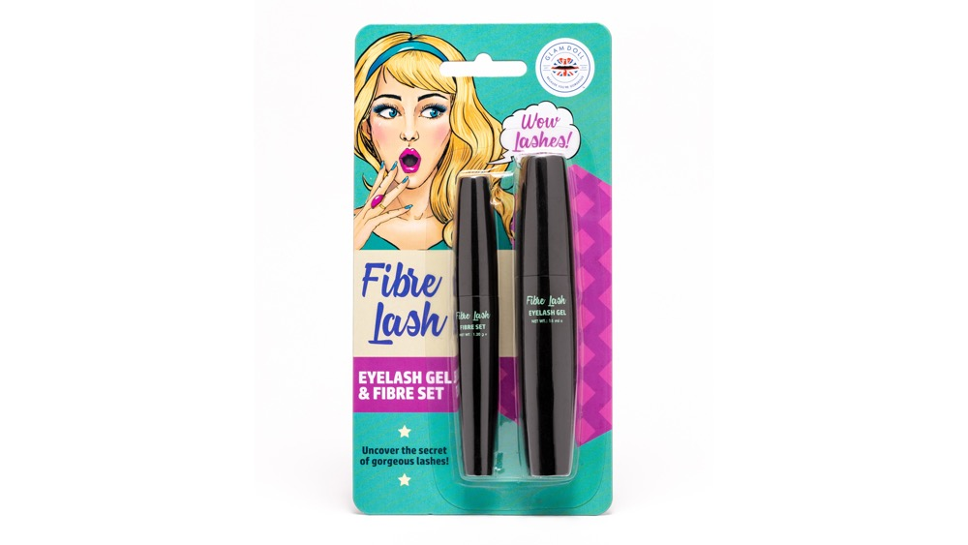
FIBRE LASH
EYELASH GEL & FIBRE SET
GEL 15 ml & FIBRE 1.20 g ℮
ITEM CODE: 1B1180
BARCODE: 5060565382046
© 2018 MIRADOR HOLDINGS LIMITED
© 2018 MIRADOR HOLDINGS LIMITED
© 2018 MIRADOR HOLDINGS LIMITED

Slide 15
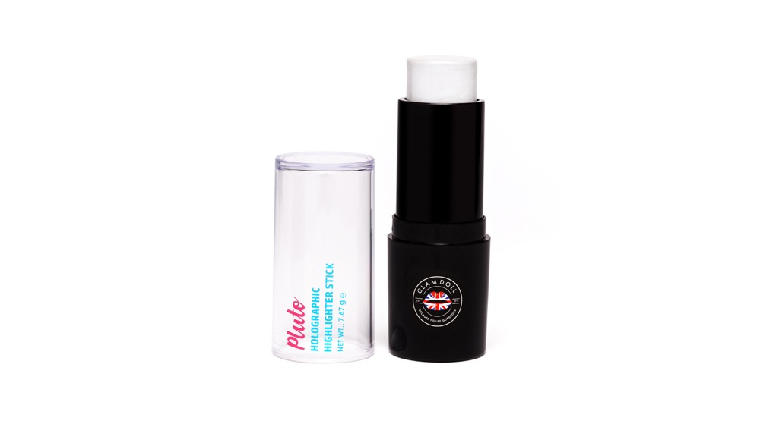
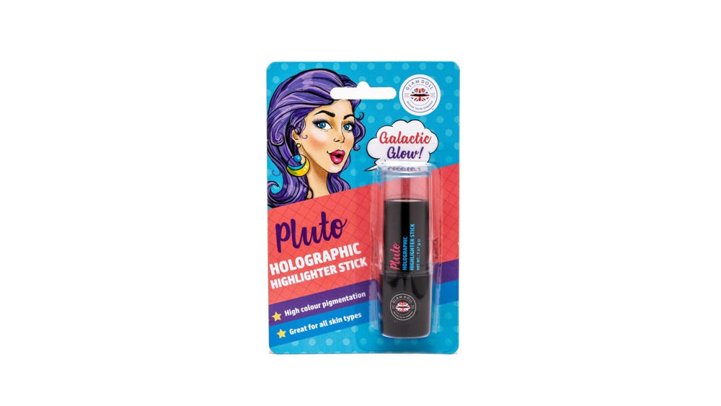
PLUTO
HIGHLIGHTER STICK
4 COLOURS
3.20 g ℮ EACH
HOLOGRAPHIC ITEM CODE: 1B1030 UPC: 5060565381582
GOLD^{NEW} ITEM CODE: 1B1031 UPC: 5060565382091
PINK^{NEW} ITEM CODE: 1B1032 UPC: 5060565382107
CHAMPAGNE^{NEW} ITEM CODE: 1B1033 UPC: 5060565382114
© 2018 MIRADOR HOLDINGS LIMITED
© 2018 MIRADOR HOLDINGS LIMITED

Slide 16
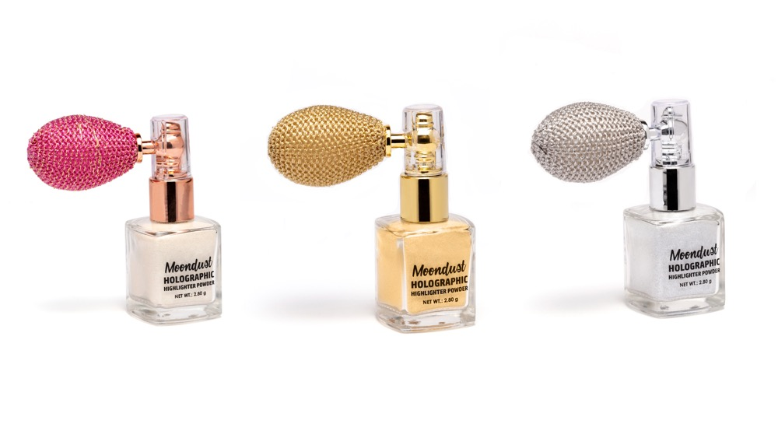
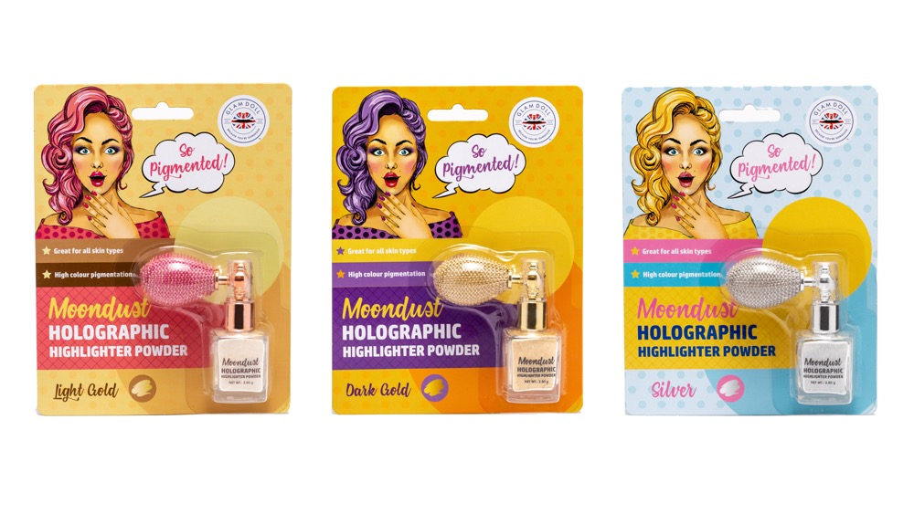
MOONDUST
HOLOGRAPHIC HIGHLIGHTER POWDER
3 COLOURS
2.80 g ℮ EACH
LIGHT GOLD ITEM CODE: 1B1040 UPC: 5060565381599
DARK GOLD ITEM CODE: 1B1041 UPC: 5060565381605
SILVER ITEM CODE: 1B1042 UPC: 5060565381612
© 2018 MIRADOR HOLDINGS LIMITED
© 2018 MIRADOR HOLDINGS LIMITED

Slide 17
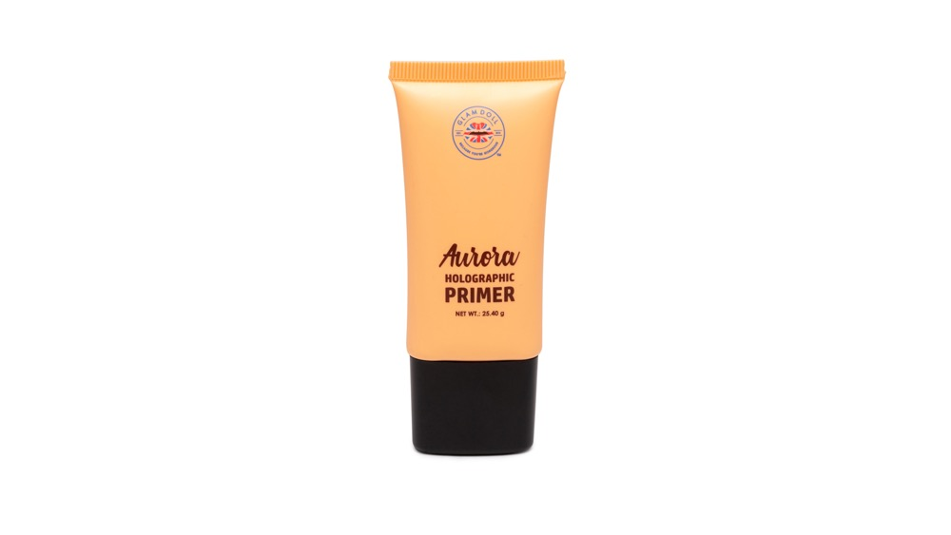
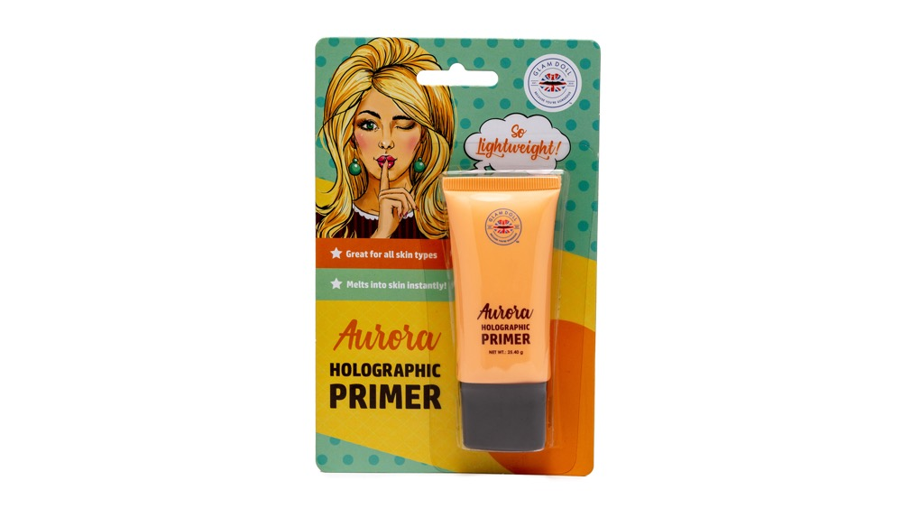
AURORA
HOLOGRAPHIC PRIMER
20.50 ml ℮
ITEM CODE: 1B1130
BARCODE: 5060565381957

Slide 18
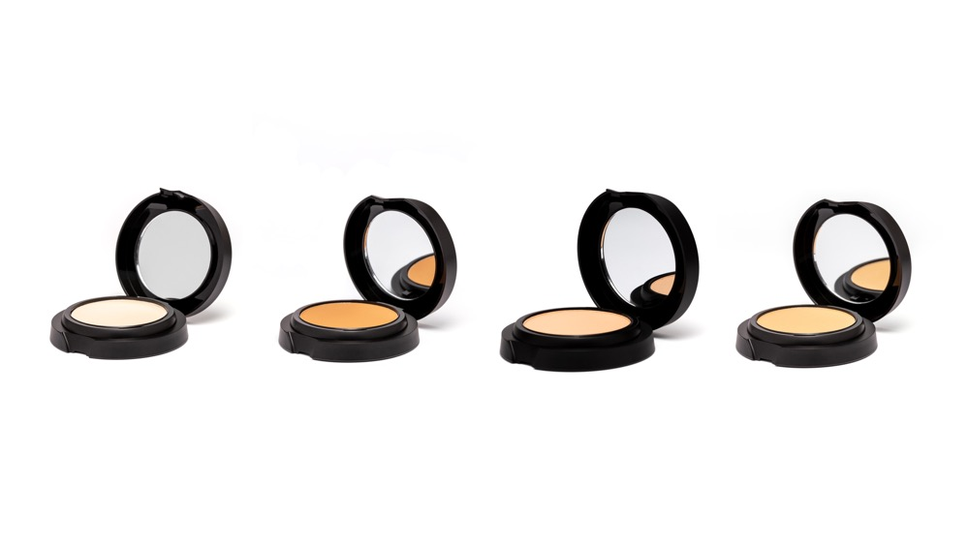
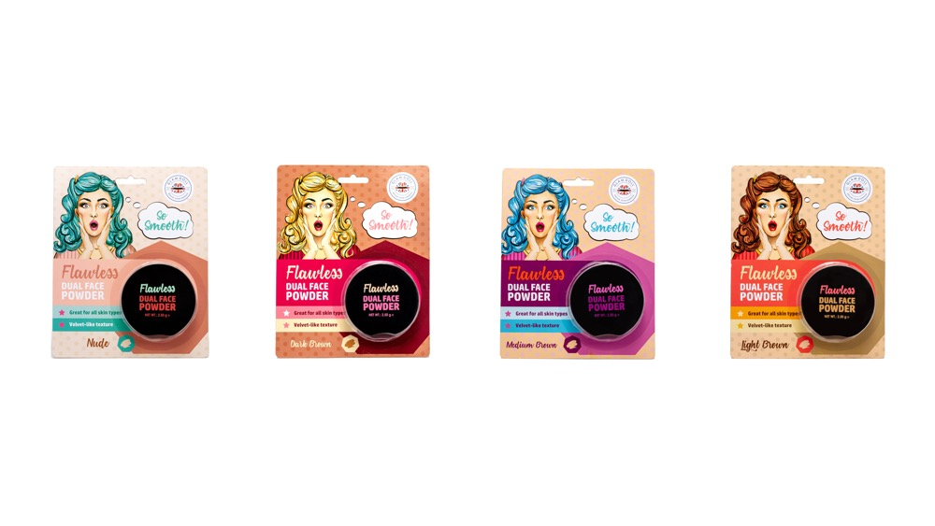
FLAWLESS
DUAL FACE POWDER
4 COLOURS
7.60 g ℮ EACH
NUDE ITEM CODE: 1B1140 UPC: 5060565381964
DARK BROWN ITEM CODE: 1B1141 UPC: 5060565381971
MEDIUM BROWN ITEM CODE: 1B1142 UPC: 5060565381988
LIGHT BROWN ITEM CODE: 1B1143 UPC: 5060565381995
© 2018 MIRADOR HOLDINGS LIMITED
© 2018 MIRADOR HOLDINGS LIMITED

Slide 19
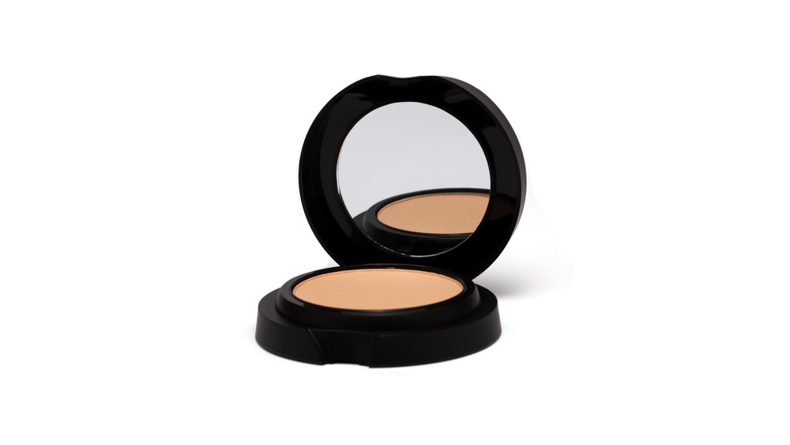
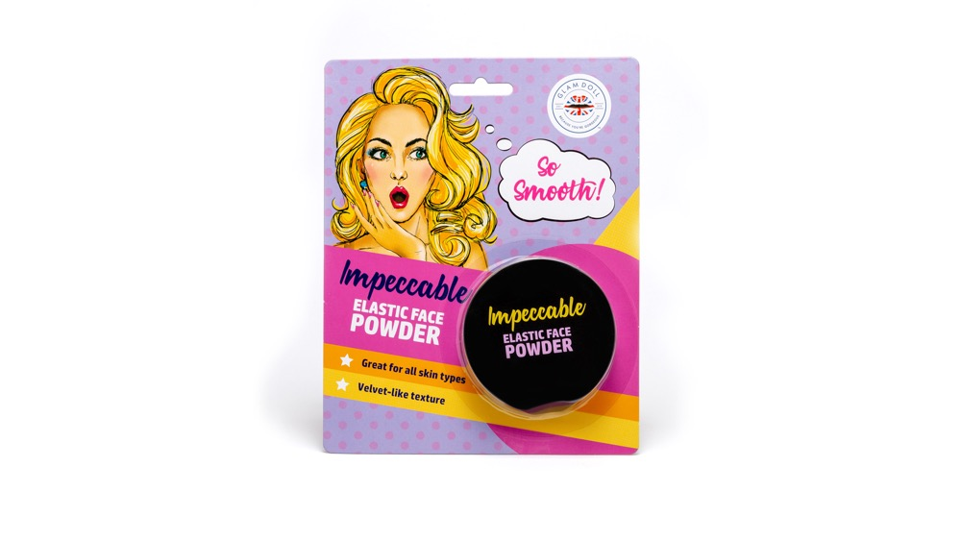
IMPECCABLE
ELASTIC FACE POWDER
8.90 g ℮
ITEM CODE: 1B1150
BARCODE: 5060565382008

Slide 20
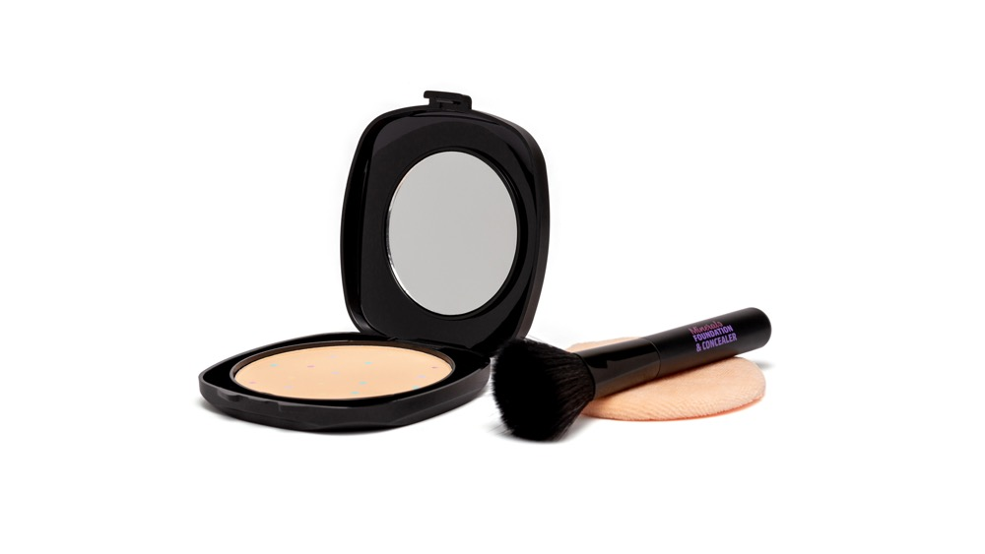
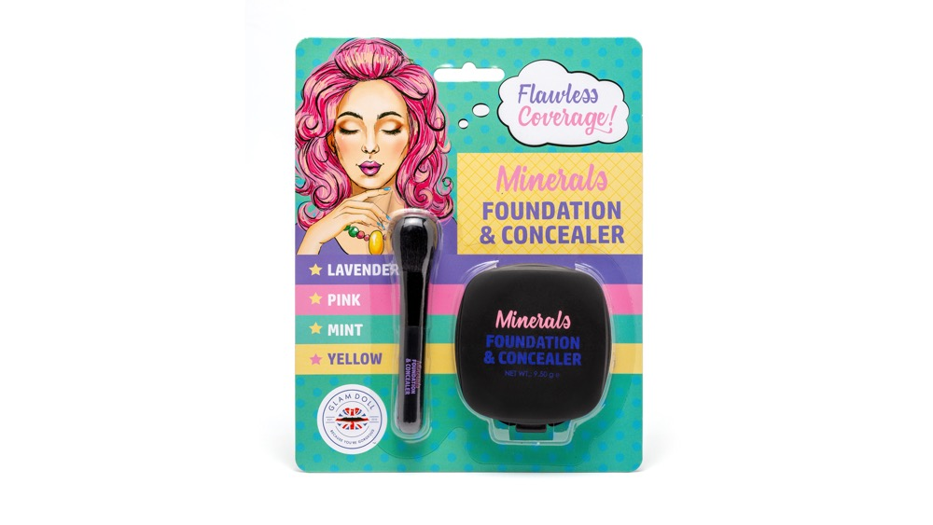
MINERALS
FOUNDATION & CONCEALER
9.50 g ℮
ITEM CODE: 1B1170
BARCODE: 5060565382039
© 2018 MIRADOR HOLDINGS LIMITED
© 2018 MIRADOR HOLDINGS LIMITED
© 2018 MIRADOR HOLDINGS LIMITED

Slide 21
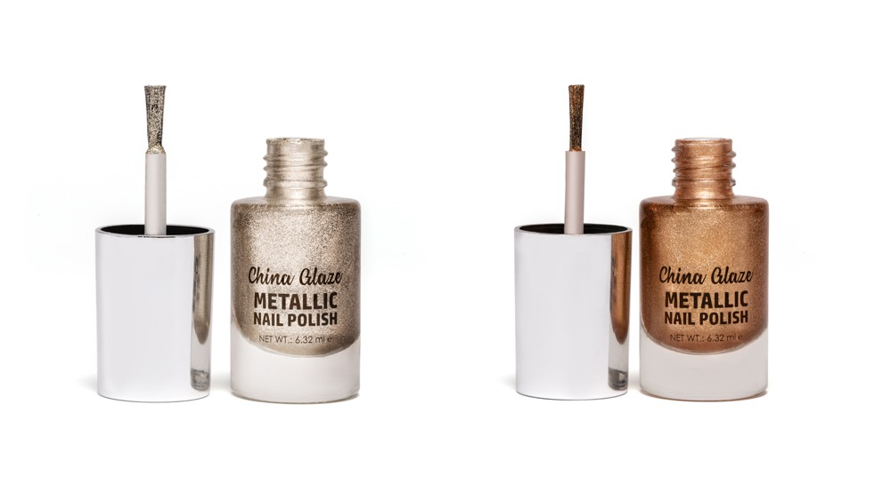
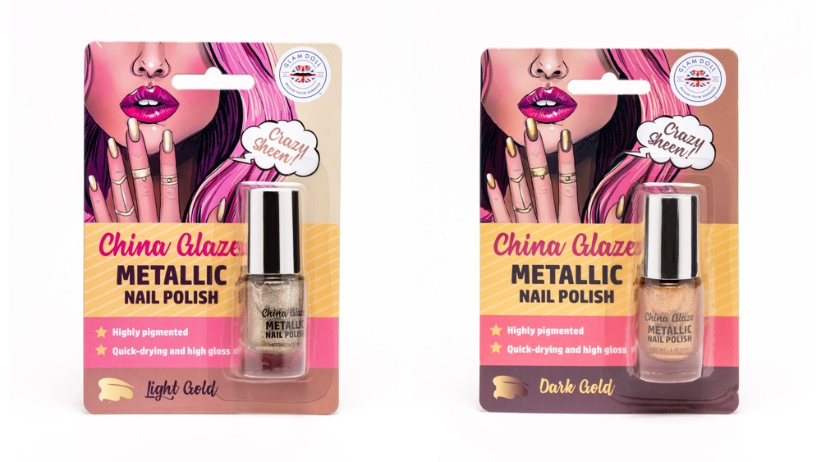
CHINA GLAZE
METALLIC NAIL POLISH
3 COLOURS
6.32 ml ℮ EACH
LIGHT GOLD ITEM CODE: 1B1160 UPC: 5060565382015
DARK GOLD ITEM CODE: 1B1161 UPC: 5060565382022
STUNNING SILVER^{NEW} ITEM CODE: 1B1162 UPC: 5060565382275
© 2018 MIRADOR HOLDINGS LIMITED
© 2018 MIRADOR HOLDINGS LIMITED

Slide 22
